Slide 1

Baby healthcare assistance module
By:
Stijn Pittomvils | Conner Maes | Alex van Daalen | Miikka Ahola | Joni Väisänen | Artuur Janssens

Slide 2
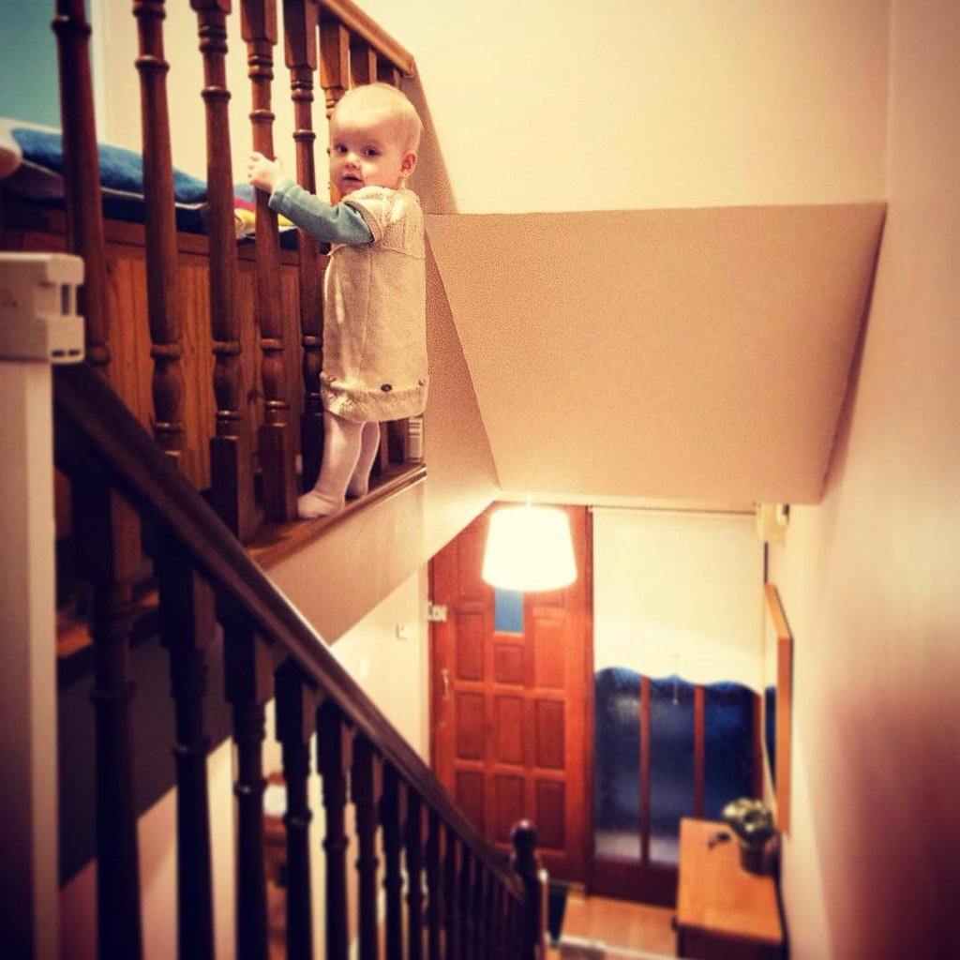
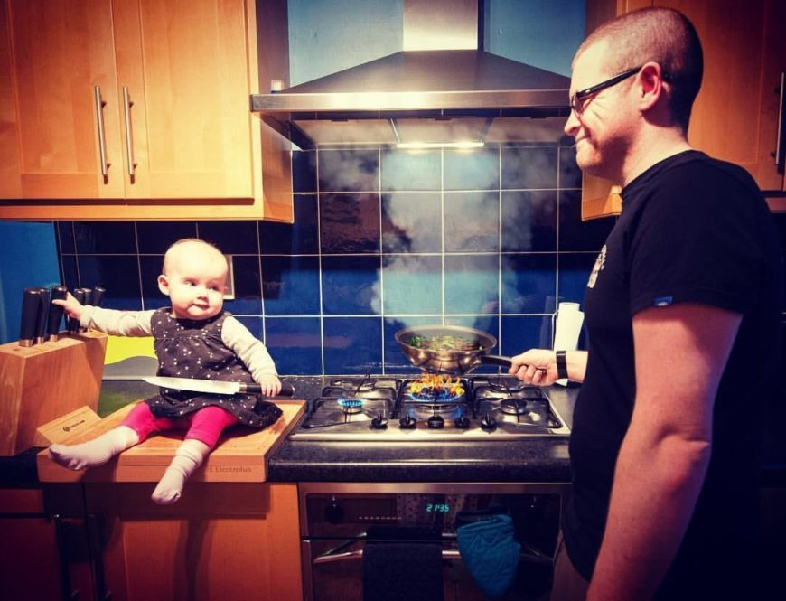
Introduction
Scared?
Woried?
Not at ease?
Notes:
So there isn’t exactly an audience in this room, except for the teacher who can relate to this but: Are you constantly scared and woried about what your baby is up to? Did you underestimate the how much effort it would take to monitor one of these little devils? Did you relise that by becomming a parent you basicly took another full time job ontop if your already existing job? Are you never at ease anyone, constatnly thinking what the baby might be up to?
Well look no further

Slide 3

Introduction
Fix
Bracelet
Monitor
Platforms
Notes:
This invention will allow you to rest with piece at mind during the night
And allows you to be somewhat less stressed at work
This is done by attatching our bracelet to your baby during the night or at the daycare,
The software will make sure that you are directly allarmed when something hapens to your golrious beatifull baby
It will send you mobile push notification whenever your baby is to cold or hot during the night or even when it is moving to hard,
It even send you a message when the baby has possibly fallen out of its crib

Slide 4
Overview
Introduction
Materials used
Raspberry & Arduino
Rest Api & database
Website
Mobile app

Slide 5
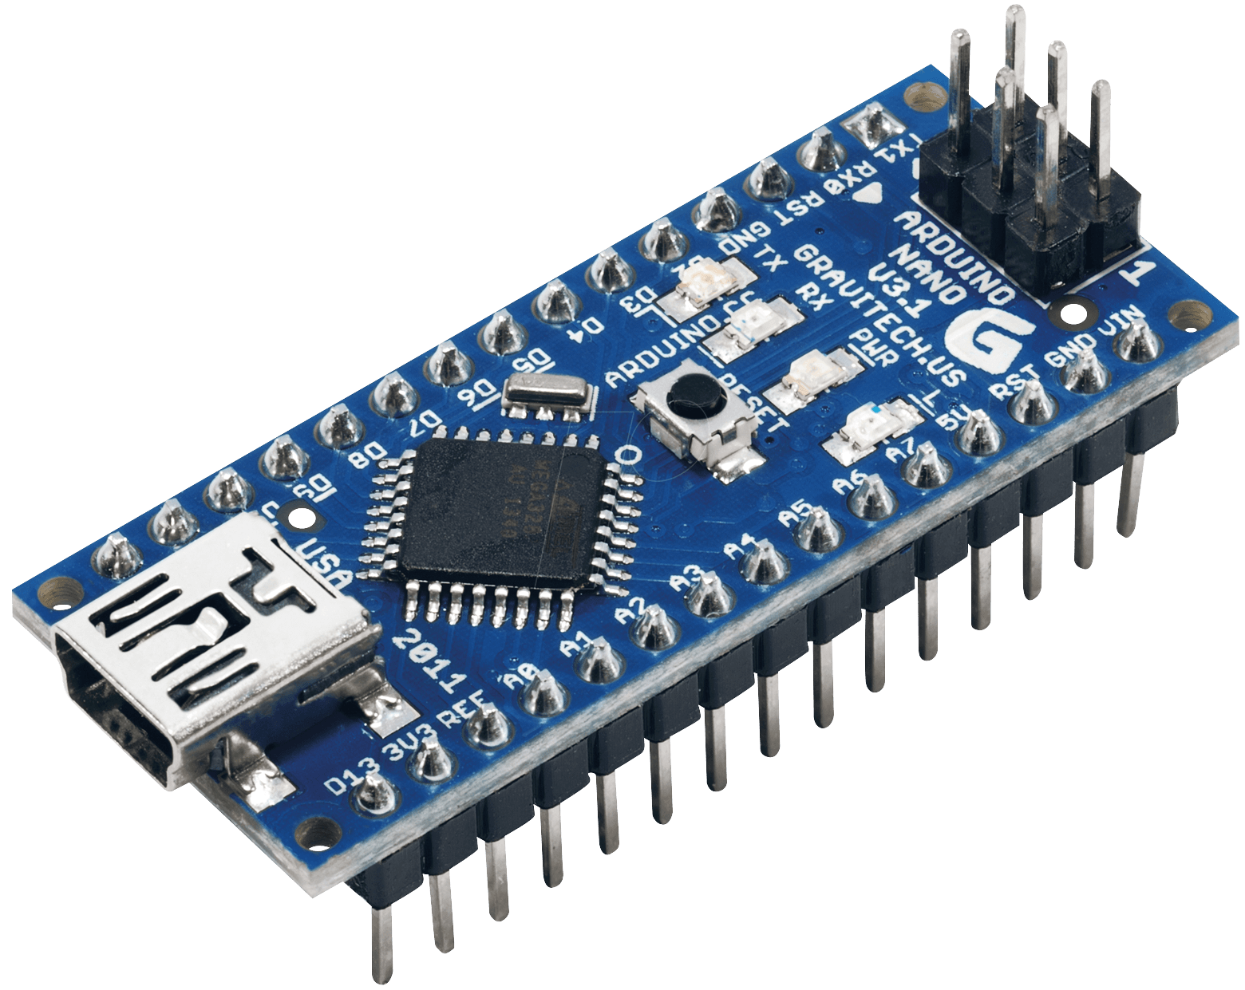
Materials used
Arduino nano
2 reasons
Size
Experience
Notes:
We’re gone start of by talking about what’s going to be inside the bracelent,
The hearth of the bracelet is the standard Arduino nano
We chhose this arduino over all the other options because of 2 reasons
1, It is acceptable small to put inside a bracelet while still maintaining enough pins
2, we have had alot of previouse experience with this model and we’re really happy with how it functions
It’s reliable and cheap compared to it’s competitors

Slide 6
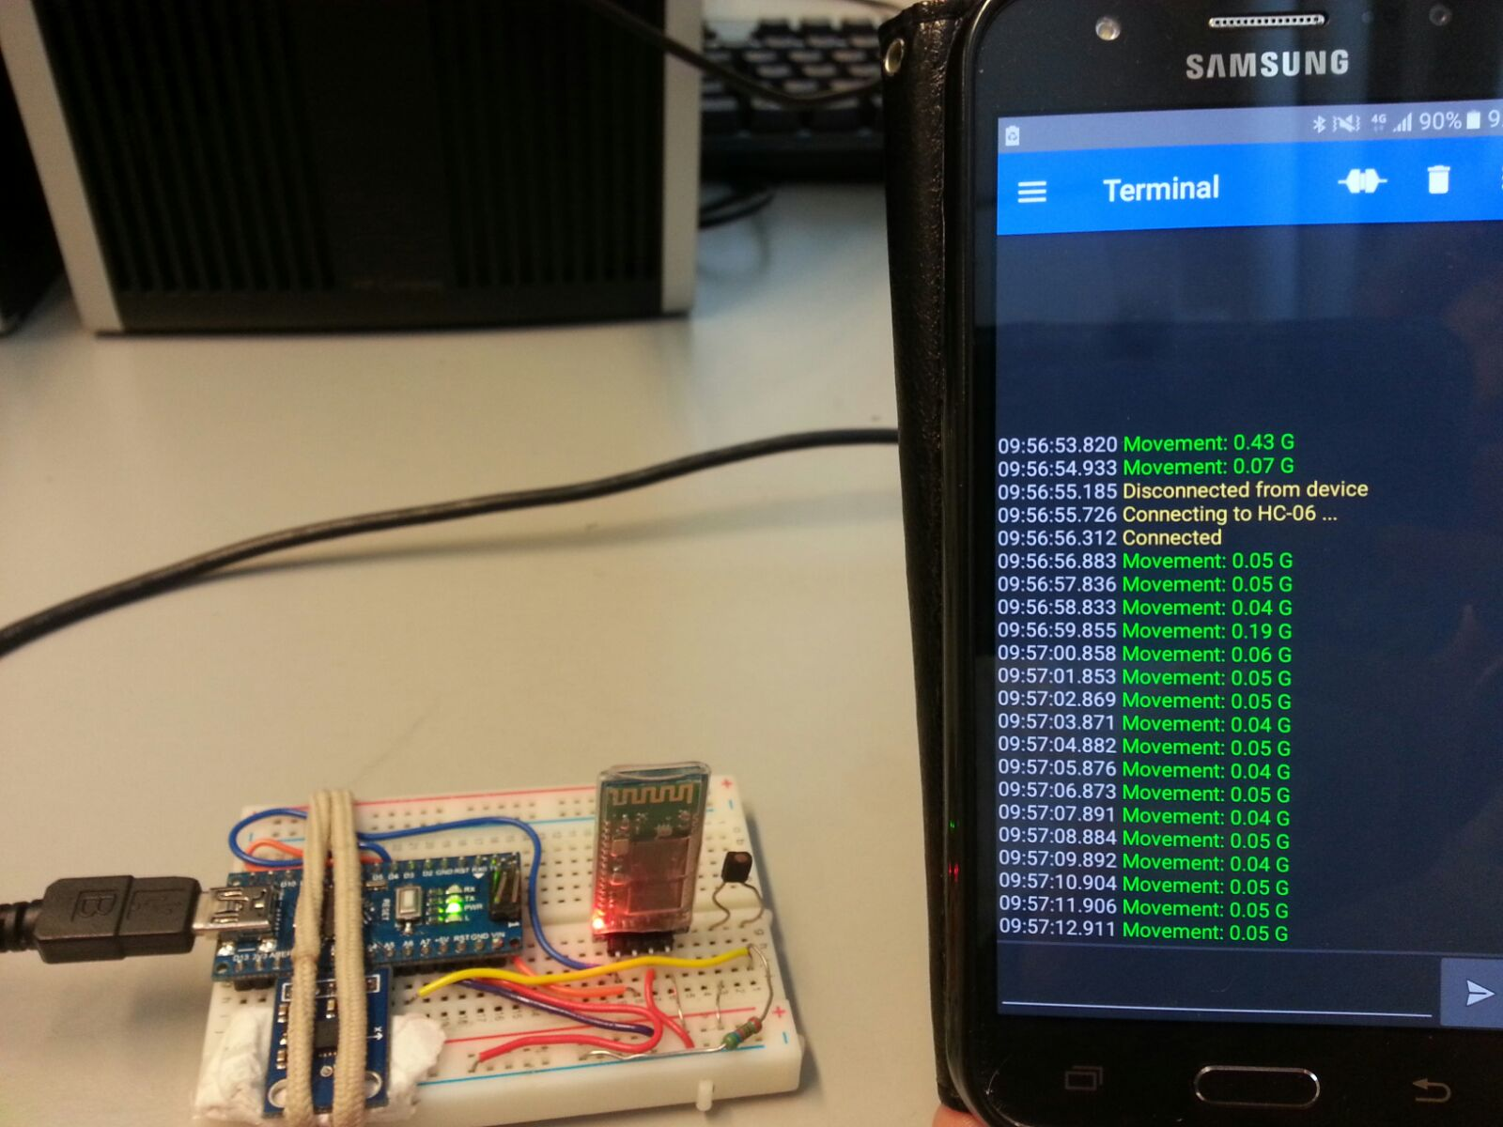
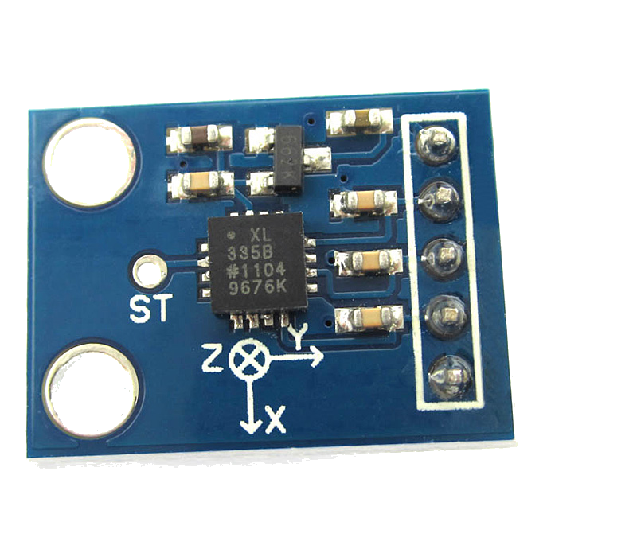
Materials used
Accelerometer
GY-61
Notes:
The chose of Accelerometer was completely up to our Finish counterparts
We had no experience with the accelerometer so we decided since they had to make the hardware
We would allow them to pick whatever fits them the best
The type we used is a Gy-61 This model posseses the cabebility to measure the Z,Y and X cordinates
In our program for the bracelet this raw data is converted to G forces
G force explenation

Slide 7
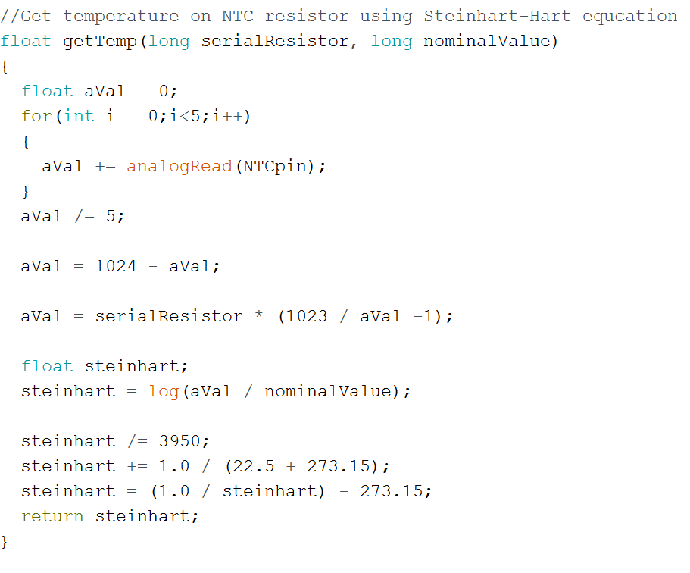
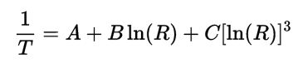
Materials used
NTC Resistor
Stein-harts equation
Notes:
As most of you will know, NTC stand for negative coefficient resistor
This means that the higher the temperature that it detects the lower the resitance it gives
We used this to get a read on our analog ports of the arduino and converted the raw data into usable temperatures
To conert the data we used the Stein-harts equation
If for some reason you were wondering what the equation looked like, here it is
We also added a coded sniped like you can see to show the equation and how it’s used

Slide 8
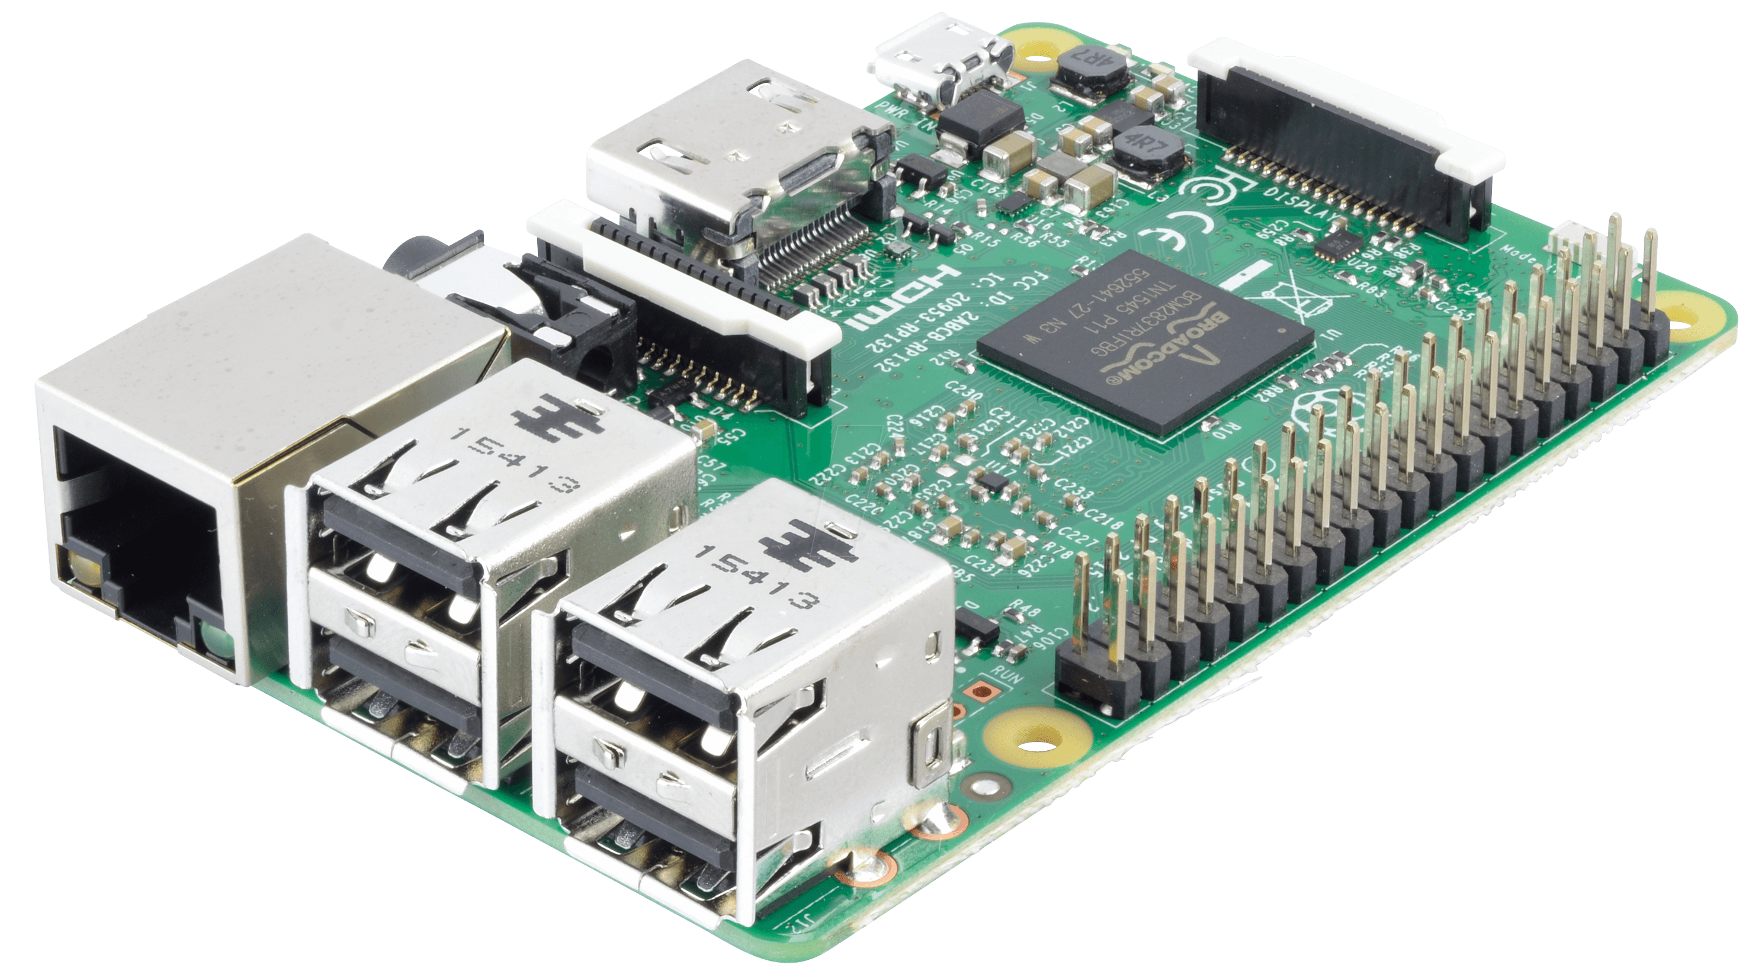
Materials used
Raspberry pi 3
Why?
Use
Ethernet vs Wifi
Notes:
The pi is going to be used as a docking station for our system
It will recieve data from the arduino in the bracelet and proces it, see when the data is to low or high
And post it to the rest api
The raspberry is going to need a ethernet cable
We chose ethernet over wifi for 2 reasons:
1, Ethernet usualy has a way better reliablity, you don’t have to see where you place it or check if it’s in wifi range
2, Most wifi conections are protected by a password these days, as some of you might know from our own raspberry pi course, getting connected to the wifi is not always easy for us,
let alone for someone who doesn’t know anything about it

Slide 9
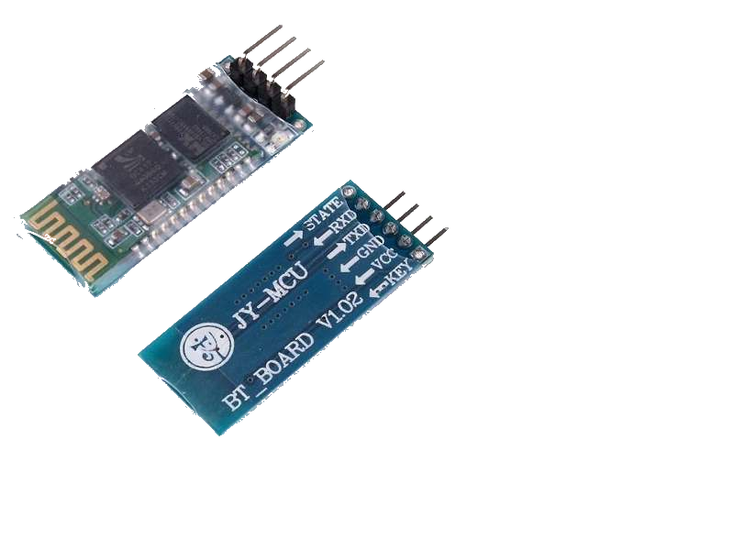
Materials used
Hc-06
Bluetooth
Alternatives
Notes:
Now that we have all these fancy things on our bracelet it’s time to connect it to our docking station
Which is placed in somewhere in the room
We used the HC06 to connect the bracelt to the pi
We had the choise to either pick an nrf24 or this Hc06
We picked the hc06 for the soul reason that the amount of issues we’ve had with the NRF24 in the past
Sadly enough i was not able to connect the HC06 to my pi, it would detect it’s presence and would connect to it,
but the librarys which I was suposed to use were either hopelessly outdated or completely overhauled so that none of the commands would work

Slide 10

Materials used
Sound sensor
Notes:
Interfere with accelerometer/HC06

Slide 11
Materials used
Product name | Price
Arduino Nano | €2,13
GY-61 | €5,37
NTC | €3,00
HC-06 | €8,65
Raspberry Pi 3B | €39,90

Slide 12
Materials Used
With docking
Without docking
Product | Price
BAHM package | €59,05
Product | Price
BAHM bracelet | €19,15

Slide 13
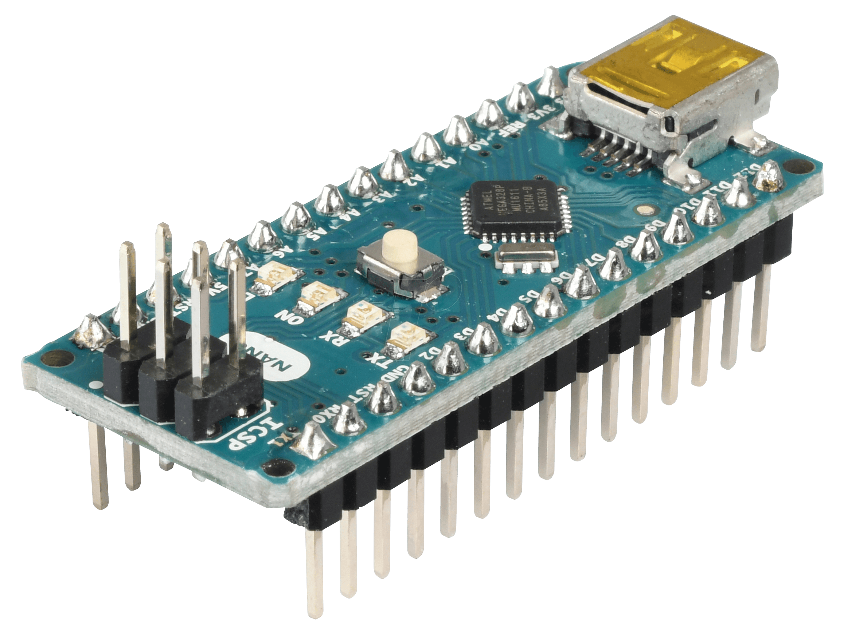
Overview
Introduction
Materials used
Raspberry & Arduino
Rest Api & database
Website
Mobile app

Slide 14
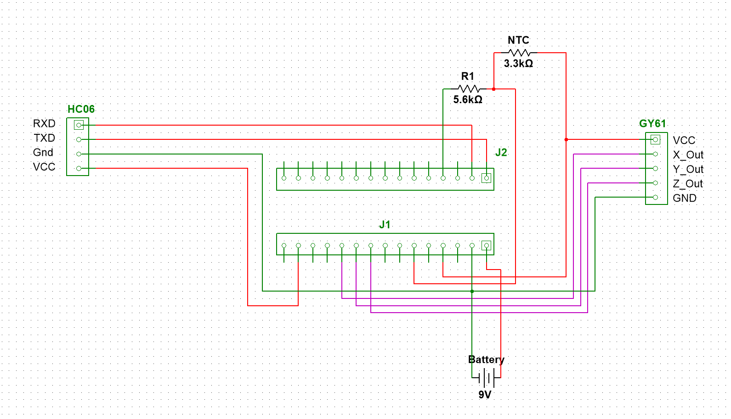
Raspberry & Arduino
Raspberry pi 3 model B
Arduino nano
Test
Expantion
Notes:
Like we mentioned befor the model for the raspberry pi is is Raspberry pi 3 model B
We chose this one becsause it’s the newest, fastest and most up to date rasppberry
It has build in bluetooth and wifi, which removes the needs of adaptors
The Pi processes the data it gets from the arduino, checks the movements if there are any abnormal values
Check if the hasn’t been movementfor a while, extreme movement (like falling) or slow movement like rolling around in your crib
Afther it processes the movement data it sends the temperature and movement data to the datbase, to do this Tuur wrote a rest API where the data gets posted to
The prototype we have does measure temperature and movement and is able to send it out with a bluetooth signal
Sadly enough I was not able to connect it to the raspberry pi, like I mentioned earlier

Slide 15
Overview
Introduction
Materials used
Raspberry & Arduino
Rest Api & database
Website
Mobile app

Slide 16

Rest API
Based on NodeJS
Custom API
Forever (daemon)
~500 lines of code
Hosted on RPi at home
Custom security (more on that later)

Slide 17

Database
MongoDB
NoSQL
Mongoose Schemes
Hosted on RPi at home

Slide 18
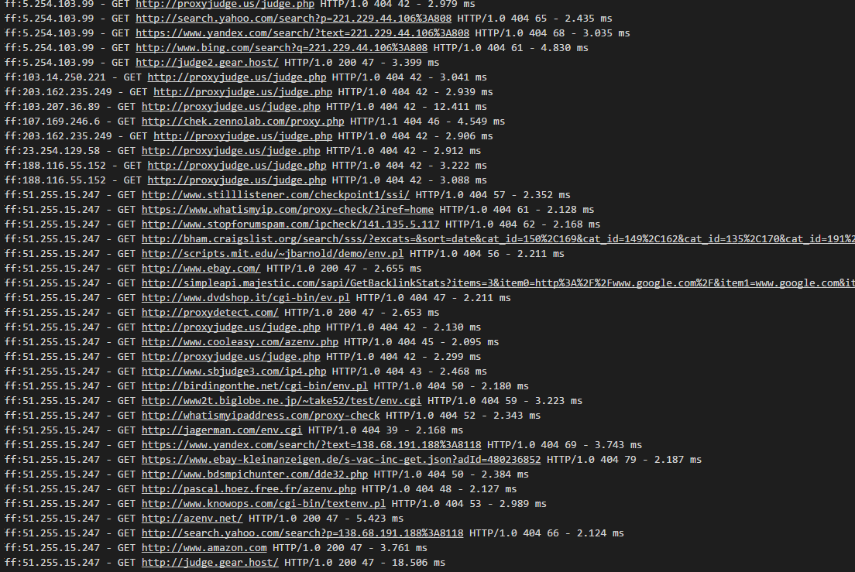
Security

Slide 19
Security
JWT tokens for login
Hashed (and salted) with Bcrypt (10 cycles)
SSH Authentication w/ PublicKey (4096 bits)
Firewall w/ iptables
Database only accessible locally
Expantion: Https (TLS)

Slide 20
Overview
Introduction
Materials used
Raspberry & Arduino
Rest Api & database
Website
Mobile app

Slide 21

Website
Angular
Bootstrap
Functions
Rest Api
Notes:
Angular: what did I use
Ng-route To make everything a single page application
And to load other views in the current active index
The reason I use dBootstrap
Boostrap: Responsive design, better than regular css easier to modify graphical layout
Functions:
Inloggen
Register
Add devices to user
Monitor different divices
Gets updates
The updates come from Tuurs rest API,
I do posts and gets

Slide 22
Overview
Introduction
Materials used
Raspberry & Arduino
Rest Api & database
Website
Mobile app

Slide 23

Mobile app
Functionality
Problems, solutions
AsyncTasks
Future improvements

Slide 24

Demos
Mobile demo
Hardware demo
Website demo

Slide 25
Ending
Summary
Quetions
Notes:
Well, this was the ending of our project,
Even though the aren’t here, I would verry much like to thank our finish friends: Miikka and joni for the amazing coöperation
It was not always an easy project to work on, we surely had our ups and down but in the end, it was worth it
We enjoyed the experience this gave us, and we believed we are ever so more prepared for what the future might bring us
If there are any questions we would love to anwser them

